Slide 1

FROM PLANS TO PERMITS
JANUARY 30, 2024
BOB CASSILLY COUNTY EXECUTIVE

Slide 2
DEPARTMENT OF PLANNING & ZONING
SHANE P. GRIMM, AICP
DIRECTOR
MOE DAVENPORT
DEPUTY DIRECTOR

Slide 3
DEPARTMENT OF PLANNING & ZONING
OVERVIEW
THE DEPARTMENT IS COMPRISED OF 3 SECTIONS
CURRENT PLANNING
GIS
LONG-RANGE PLANNING
Administrative staff
Building Permits Center
Development Review
Board of Appeals
Development Advisory Committee (DAC)
Mapping
Data collection & analysis
Maintain WebGIS platform
Data & Demographics
Environmental Planning
Transportation Planning
Land Use Planning

Slide 4
DEPARTMENT OF PLANNING & ZONING
COMPREHENSIVE ZONING TIMELINE
Comprehensive Zoning
Introduce Zoning Bill to Suspend and Initiate Comp Zoning
Council Hearing Bill
Zoning Applications (60 day)
Staff Review Applications and Make Recommendations
FEB 2024
FEB 2024
MARCH 1, 2024
APR/MAY 24
Comprehensive Zoning
Public Meetings
PAB Review
Introduce Legislation
Council Hearings
New Zoning Maps
JUN 2024
JUL 2024
AUG 2024
SEPT 24
OCT 24

Slide 5
DEPARTMENT OF PLANNING & ZONING
HOT TOPICS
Forest Conservation Act (FCA) – During last session, the State passed drastic changes to the Forest Conservation Act that will significantly impact development throughout the State.
Traffic Impact Analysis (TIA) – The County Council passed changes to Adequate Public Facilities (APF) that requires the County to initiate the preparation of a traffic study for non-residential uses instead of the developer.
Solar Power Generation – It is anticipated that the State will pass legislation that will further pre-empt local regulation of certain solar power generation facilities.
Agricultural Commercial Uses – The commercial use of farms for agricultural and non-agricultural activities is continually evolving. The County in coordination with various agencies and stakeholders will be evaluating changes to the Zoning Code to address the changing nature of agriculture, agri-tourism and agri-business.

Slide 6
DEPARTMENT OF PLANNING & ZONING
KEY CONTACTS
Main Office | 410-638-3103
Shane Grimm Director | spgrimm@harfordcountymd.gov
Moe Davenport Deputy Director | mddavenport@harfordcountymd.gov
Alex Rawls Long Range Planning (Environmental and Transportation) | aarawls@harfordcountymd.gov
Bruce Johnson Chief, Geographic Information Systems (GIS) | bpjohnson@harfordcountymd.gov
Dee McCready Plan Review and Circulation | dmmcready@harfordcountymd.gov

Slide 7
DEPARTMENT OF PUBLIC WORKS
JOE SIEMEK, PE
DIRECTOR

Slide 8
DEPARTMENT OF PUBLIC WORKS
PRESENTATION OUTLINE
Basis for DPW Review and Approval
Our Approach to Review Process
Current Operations
Key Contacts in Public Works

Slide 9
DEPARTMENT OF PUBLIC WORKS
BASIS FOR DPW REVIEW/APPROVAL
County Code or State Law
Stormwater, Traffic, Sediment, etc.
Facilities To Be Owned by County
Roads, Water, Sewer, etc.

Slide 10
DEPARTMENT OF PUBLIC WORKS
APPROACH TO REVIEW PROCESS
Target Turnaround at Max 30 Days
Follow the Rules – Be Reasonable
“Need to Have” vs “Nice to Have”
Give a Path to “Yes”

Slide 11
DEPARTMENT OF PUBLIC WORKS
CURRENT OPERATIONS
DPW Organized in Three Divisions
Highways
Water & Sewer
Environment & Sustainability

Slide 12
DEPARTMENT OF PUBLIC WORKS
PERMIT PROCESSES
Highways
Roads & Storm Drainage
Traffic Impact Studies
Public Works Agreements
Performance Bonds
Roads, Drainage and Sidewalks

Slide 13
DEPARTMENT OF PUBLIC WORKS
PERMIT PROCESSES
Water & Sewer
Water & Sewer Facilities
Commercial Service Applications
Public Works Utility Agreements
Performance Bonds

Slide 14
DEPARTMENT OF PUBLIC WORKS
PERMIT PROCESSES
Environment & Sustainability
Grading & Sediment Control
Storm Water Management
Maintenance Agreements
Performance Bonds
Soil Conservation Service

Slide 15
DEPARTMENT OF PUBLIC WORKS
KEY CONTACTS
Joe Siemek, PE Director | jjsiemek@harfordcountymd.gov 410-638-3285
HIGHWAYS
Steve Walsh, PE Deputy Director | sawalsh@harfordcountymd.gov 410-638-3509 Ext 1375
Glen Hebel, PE Chief, Highway Engineer | ghebel@harfordcountymd.gov 410-638-3509 Ext 1344
WATER & SEWER
Bill Bettin, PE Deputy Director | wjbettin@harfordcountymd.gov 410-638-3300 Ext 3159
Dave Burke, PE Chief, W&S Planning & Admin | dmburke@harfordcountymd.gov 410-638-3300 Ext 3370
ENVIRONMENT & SUSTAINABILITY
Steve Walsh, PE Deputy Director | sawalsh@harfordcountymd.gov 410-638-3509 Ext 1375
Bob Anderson, PE Senior Stormwater Engineer | reanderson@harfordcountymd.gov 410-638-3509 Ext 1363

Slide 16
DEPARTMENT OF INSPECTIONS, LICENSES & PERMITS
RICH TRUITT
DIRECTOR
HAROLD BOLING
DEPUTY DIRECTOR

Slide 17
DEPARTMENT OF INSPECTIONS, LICENSES & PERMITS
DEPARTMENT RESPONSIBILITIES
The Department of Inspections, Licenses and Permits is comprised of three divisions and administrative support staff.
Provides third party inspection services for City of Aberdeen, Town of Bel Air, and City of Havre de Grace.
Responsible for building, electrical, plumbing, HVAC and fuel gas permits and inspections.
Licensing and Trade Registrations.
Plan Review Target Goal – Plans are reviewed within 10 working days from submittal.
INSPECTION TOTALS FY23
Building (Harford County) | 11,261
Building (Aberdeen) | 969
Building (Bel Air) | 753
Building (Havre de Grace) | 1,247
Building Services | 14,230
Electrical Services | 16,382
Plumbing | 6,654
Mechanical | 4,768
Fuel Gas | 894
On Site Utility | 23
Plumbing Services | 15,932
Grand Total | 46,544
BUILDING PERMIT TURN AROUND TIME FY23 | FY22-23 YTD
Permits Applied For | 2,467
Average Days to Issue | 26.30
Median Days to Issue | 11.25
Percentage Permits Issued 5 Days or Less | 29.43%
Percentage Permits Issued 15 Days or Less | 57.24%
Percentage Permits Issued 30 Days or Less | 72.11%
Average Commercial | 35.11
Average Residential | 24.16
Unissued at 6 months | 32.00
Application Expired | 65.00
PERMIT TOTALS FY23
Building Permits | 2,467
Electrical Permits | 5,736
Fuel Gas Permits | 2,075
Mechanical Permits | 2,925
Plumbing Permits | 2,607
Public Event Permits | 1
On Site Utility Permits | 18
Grand Total | 15,829

Slide 18
DEPARTMENT OF INSPECTIONS, LICENSES & PERMITS
SUBMISSION PROCESS
Top reasons for resubmissions -
Incomplete documents
Inaccurate Code References.
Take time to review documents prior to submittal.
RESIDENTIAL SUBMITTALS | COMMERCIAL SUBMITTALS
Site Plan (accurate and fully dimensioned). | Site Plan (accurate and fully dimensioned). | Plans must be Signed and Sealed.
Accurate Floor Plans, Cross Sections, Details. | Accurate Floor Plans, Sq Footage, Cross Sections, Details. | Life Safety Plan with occupant load calculations and egress paths.
Energy Code Submittal and Compliance. | Energy Code Submittal and Compliance. | Review for suppression and fire alarm systems.
Applicable Code References. | Height and Area Analysis with construction type and occupancy classifications.
Engineering documentation for details not within prescriptive base code. | Accessibility Review. For existing structures disproportionality review.
 | Applicable Code References.
 | Fire Rated assembly documentation. i.e. tested design references.

Slide 19









DEPARTMENT OF INSPECTIONS, LICENSES & PERMITS
2021 CODE UPDATES
Department will be submitting legislation to adopt the following codes:
2021 International Building Code
2021 International Existing Building Code
2021 International Residential Code
2021 International Energy Conservation Code
2021 International Swimming Pool and Spa Code
2021 International Plumbing Code
2021 International Mechanical Code
2021 International Fuel Gas Code
2023 National Electrical Code NFPA 70
Adoption date prior to May 29, 2024
Digital Code Access https://codes.iccsafe.org/codes/maryland/harford-county-md

Slide 20
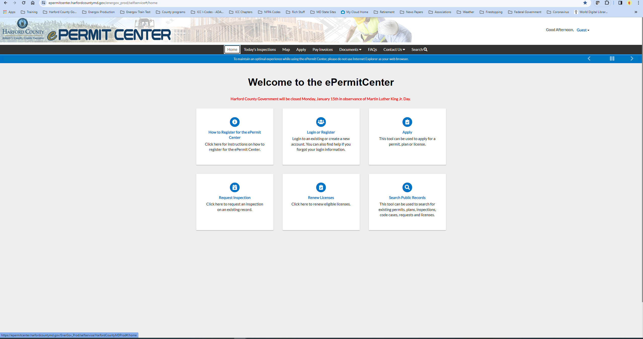
DEPARTMENT OF INSPECTIONS, LICENSES & PERMITS
E-PERMIT CENTER
Conduct business more efficiently with Harford County.
24/7 access to permitting information. With enhanced access for account holders.
24/7 ability to apply for permits.
Ability to schedule inspections online.
Ability to upload documents.

Slide 21
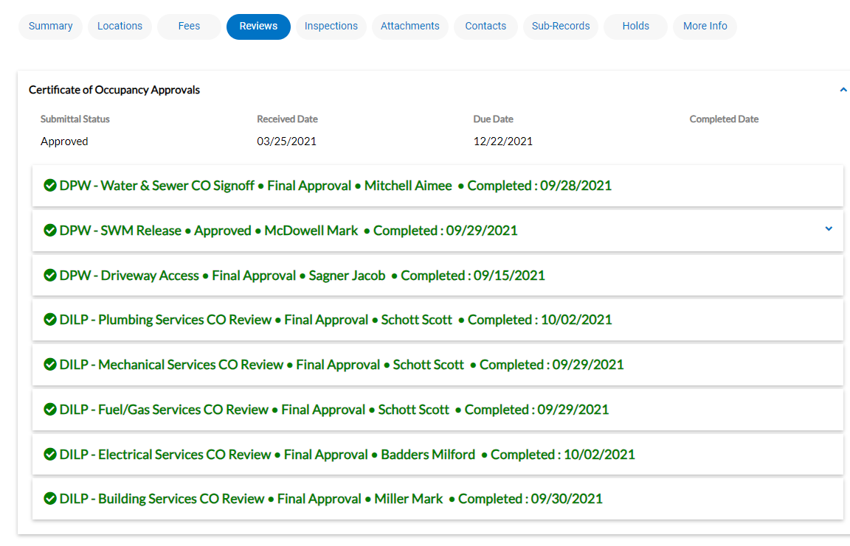
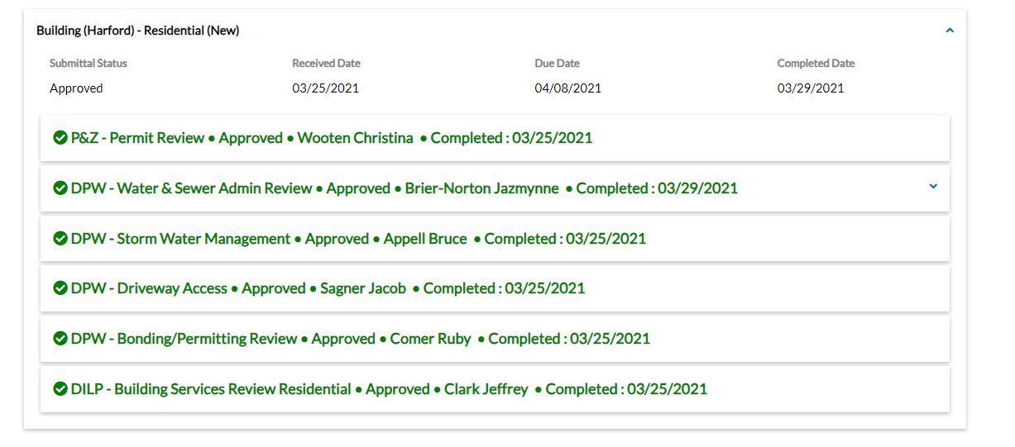
DEPARTMENT OF INSPECTIONS, LICENSES & PERMITS
E-PERMIT CENTER
Certificate of Occupancy Agency Reviews.
Permit Issuance Agency Reviews.

Slide 22



DEPARTMENT OF INSPECTIONS, LICENSES & PERMITS
ENVIRONMENTAL HEALTH TECHNOLOGY UPGRADES AND UPDATES
County is incorporating Environmental Health business processes into Energov permitting platform:
Project includes four-phase upgrade that includes more than 93 business processes.
First phase of residential well and septic inspections and Burn Permitting goes live February 2024.
Future phases will include food licensing and inspections.
Permitting of business processes.

Slide 23
DEPARTMENT OF INSPECTIONS, LICENSES & PERMITS
KEY CONTACTS
DIRECTORS OFFICE
Rich Truitt, Director | rctruitt@harfordcountymd.gov 410-638-3122
Harold Boling, Deputy Director | hwboling@harfordcountymd.gov 410-638-3122
PLANS REVIEW
Maria Nelson, Senior Plans Examiner | manelson@harfordcountymd.gov
Cody Davis, Senior Plans Examiner | cjdavis@harfordcountymd.gov
Jeff Clark, Plans Examiner II | jcclark@harfordcountymd.gov
DIVISION CHIEFS
Debbie Wildberger, Permits Office | diwildberger@harfordcountymd.gov
Milford Badders, Electrical Division | mlbadders@harfordcountymd.gov
Scott Schott, Plumbing, Mechanical Division | plumbing@harfordcountymd.gov
Dave Cross, Building Division | dmcross@harfordcountymd.gov
EPERMIT CENTER AND ENERGOV TECHNOLOGY
Heather McHugh, Project Manager | hjmchugh@harfordcountymd.gov
OFFICE OF THE STATE FIRE MARSHAL
Harry Bradley, Senior Fire Protection Engineer | Harry.Bradley@maryland.gov
Michael L. Hayden (Chap), Fire Safety Inspector | Michael.Hayden@maryland.gov

Slide 24
OFFICE OF ECONOMIC DEVELOPMENT
Shawn Krout Business Development Associate
& Business Navigator

Slide 25
OFFICE OF ECONOMIC DEVELOPMENT
LIFE CYCLE OF THE COMMERCIAL DEVELOPMENT PROCESS
Site plan submittal and review by Dept. of Planning & Zoning and other departments; Plan is scheduled for Development Advisory Committee (DAC); Site plan approval issued
Submittal of engineering plans and permits to Dept. of Public Works – stormwater management, grading/sediment control, road plans, bonding, etc.
Submittal of building permits/trade permits to Dept. of Inspections, Licenses & Permits (DILP) and other reviewing agencies
DILP to perform inspections; Other agencies must sign off prior to issuance of C&O permit
After reviewing agencies sign off on C&O, business can officially open; Office of Economic Development coordinates ribbon cutting and supports business needs
Commercial development is a collaborative effort between the business, all reviewing Harford County Government departments, and other local/state partners

Slide 26
OFFICE OF ECONOMIC DEVELOPMENT
BUSINESS NAVIGATOR
Created by the County Executive as primary point of contact for “one-stop-shop” to monitor commercial business development and answer questions that may arise
Provides streamlined and efficient process to simplify doing business with Harford County Government
Serves as liaison with other departments/state agencies/local municipalities to facilitate smooth review process
GOALS
Provide exceptional customer service from project inception to completion; identify bottle necks and resolve issues efficiently
Provide resources to other county departments, state partners, local municipalities, etc. to ensure effective collaboration
Touch point every 30 days with engineers/consultants on each project
Strengthen relationships with engineers, consultants, partners
Notes:
Position was created to provide assistance (one-stop-shop) for the overall commercial development process and create a streamlined and efficient process to make it simple to do business with Harford County
How do businesses get on my radar?
Emails and phone calls to OED office
Inquiries through other County departments, state partners, municipalities
Spin-offs from existing business meetings
Social media
Prospects identified through OED outreach efforts (such as commercial real estate brokers)
Networking partners – Harford Chamber, Route 40 Business Association, SWN, HCC, HCPS
APG organizations and government contractors

Slide 27
OFFICE OF ECONOMIC DEVELOPMENT
BUSINESS NAVIGATOR
Business Navigator Project Tracker (4 of 4)
All Systems Go
Delay Identified
(over 30 days)
Project Stalled (over 60 days)
BUSINESS/PROJECT NAME | STATUS | LAST CONTACT | NEXT CONTACT
ABC Company, Inc. Solar Project | ↑ | Week of 1/8 | Week of 2/5
Smith, LLC | ↗ | Week of 1/8 | Week of 2/5
Example Business Park Project FAST TRACK PROJECT Signed by CE | ↑ | Week of 1/15 | Week of 2/19
New Business S388-2023 | ↓ | Week of 1/22 | Week of 2/26
Notes:
How are these projects tracked?
Detailed tracking document using Microsoft TEAMS (P&Z, DPW, DILP have access to document and provide weekly update)
Integration of County software (Energov, GIS)
Weekly communication with all partners
How many projects are being tracked?
Number of projects will vary by commercial development plans submitted to the County
Total projects being tracked as of today (1/30/24): 31
Number of projects completed: 4
Fast Track projects: 1

Slide 28
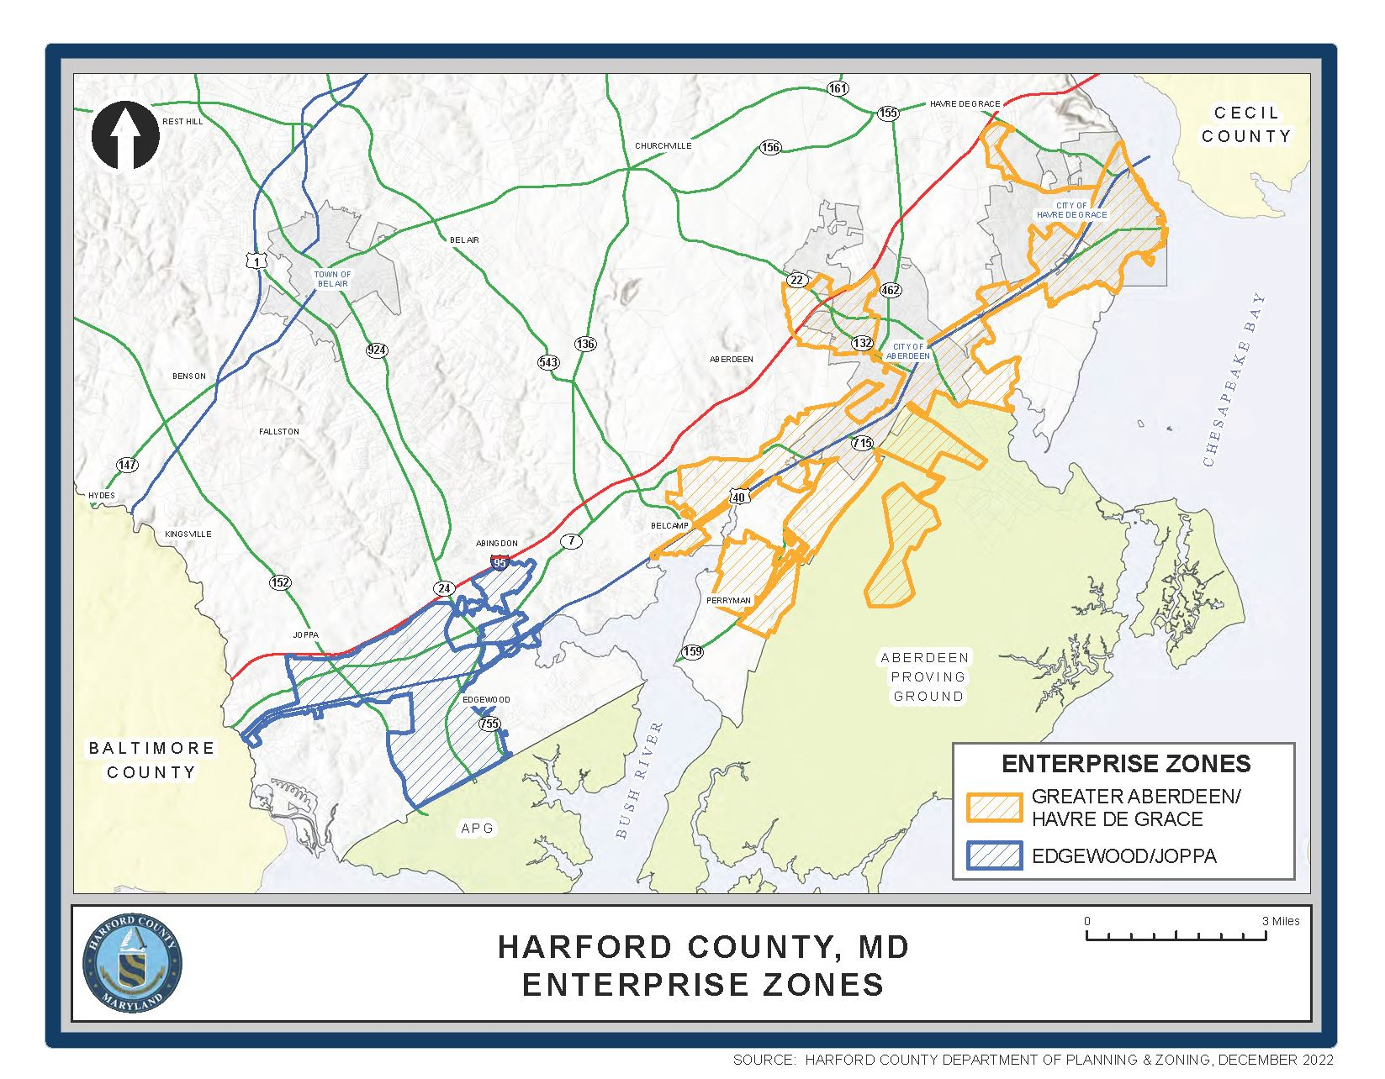
OFFICE OF ECONOMIC DEVELOPMENT
ENTERPRISE ZONES
ABERDEEN/ HAVRE DE GRACE
9,738 acres (updated 2024)
$418M in capital investments since 2006
Properties along U.S. Route 40 and in Aberdeen and Havre de Grace municipalities
East to include portions of Aberdeen Proving Ground
South to Belcamp and Perryman
EDGEWOOD/ JOPPA
4,328 acres (updated 2024)
$148M in capital investment since 2006
Properties situated along U.S. Routes 40 and 7, and MD 24, 755, 152
Harford County's two Enterprise Zones in Aberdeen/Havre de Grace and Edgewood/Joppa are designated by the Maryland Department of Commerce to:
Encourage the creation of NEW jobs with tax credits
Real property tax credit over a 10-year period with a minimum capital investment
Ensure retention and spur expansion of resident businesses
Promote development and occupancy of vacant, underutilized land and buildings
https://www.harfordcountymd.gov/1280/Enterprise-Zones

Slide 29

OFFICE OF ECONOMIC DEVELOPMENT
FAST TRACK 2.0
THINGS TO REMEMBER:
Priority review and processing
Track progress and get one-on-one support
Subject to eligibility requirements
Program updated to take advantage of Business Navigator and Energov technology
Targeted to projects with beneficial economic impact to Harford County
Fast Track 2.0 projects receive prioritized reviews and process by all County agencies
Dedicated point of contact with Business Navigator

Slide 30
OFFICE OF ECONOMIC DEVELOPMENT
RESOURCES
BIZ BYTES NEWSLETTER
Sent out first week of every month
Business news and events, funding and resources, and more
Email oed@harfordcountymd.gov to sign up
OED WEBSITE
Visit www.harfordcountymd.gov/718/Economic-Development to learn how we can help your business grow and thrive
Workforce Technical Training Grant
Economic Development Opportunity Fund
Site selection
Partner, resource connections
STATISTICS REPORT AND DATASTORY
Using data to tell our story

Slide 31
OFFICE OF ECONOMIC DEVELOPMENT
KEY CONTACTS
Main Office | oed@harfordcountymd.gov 410-638-3059
Karen Holt Director | klholt@harfordcountymd.gov 410-638-3058
Raj Goel Deputy Director | rkgoel@harfordcountymd.gov 410-638-4832
Shawn Krout Business Development Associate/Business Navigator | slkrout@harfordcountymd.gov 410-638-3414

